Slide 1


On-Device CPU Scheduling for Robot Systems
Aditi Partap*, Samuel Grayson, Muhammad Huzaifa, Sarita Adve, Brighten Godfrey, Saurabh Gupta, Kris Hauser, Radhika Mittal
University of Illinois at Urbana-Champaign *Stanford University
Notes:
Hi everyone, Im Aditi and today I’ll be presenting our work on on-device cpu scheduling for robotics. This work was done during my Masters and is in collab with folks at UIUC.

Slide 2
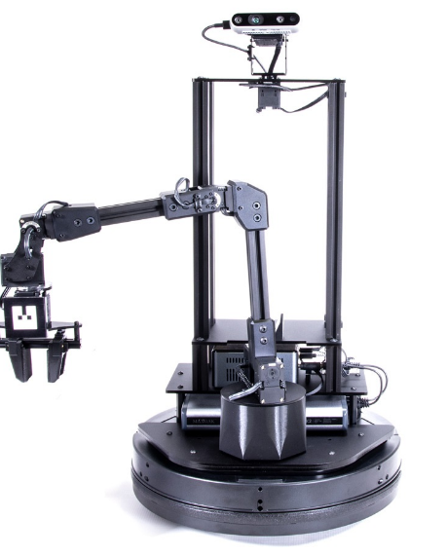
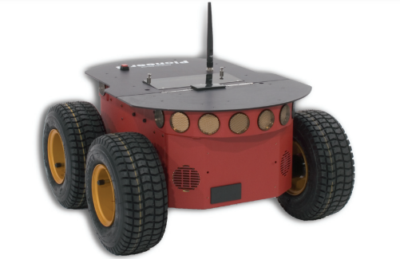
Robots have limited CPU resources
Most robots run on on-board chips with limited CPU
LocoBot^{[1]}: 2-Core Intel NUC
P3at: 2-Core Intel PC
1. http://www.locobot.org/
Notes:
We start with an observation that, most low-cost robots have limited CPU resources as they use small on-board chips E.g. LocoBot and p3At both run on a 2-core Intel processor.

Slide 3
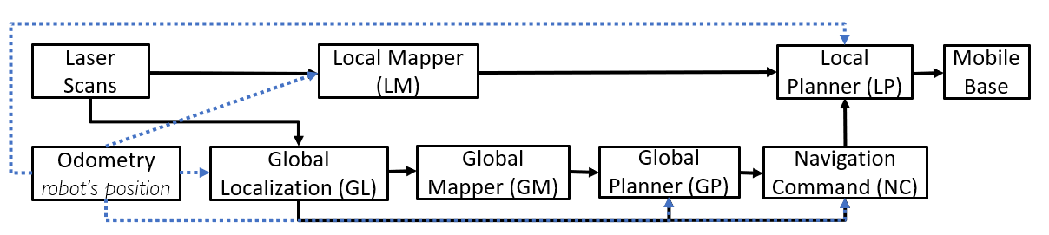
Robots run complex applications
Example: Nav2d
Notes:
The 2nd observation is that robots run complex applications. As an example, We look at Nav2d, which is a navigation application built on top of ROS. Here’s the DAG for Nav2d.

Slide 4
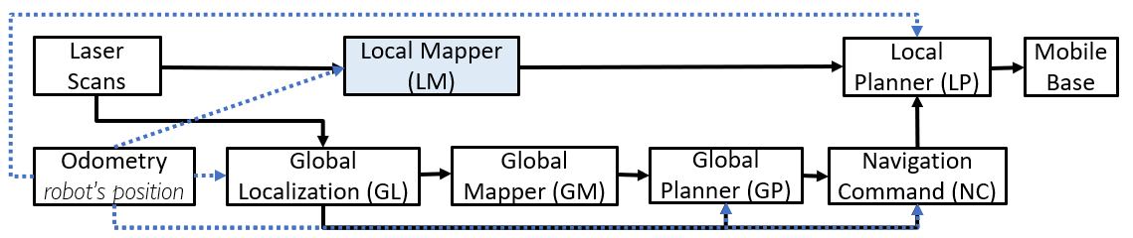
Robots run complex applications
Local Mapping
Notes:
This DAG has a lot of components - there’s local mapping,

Slide 5
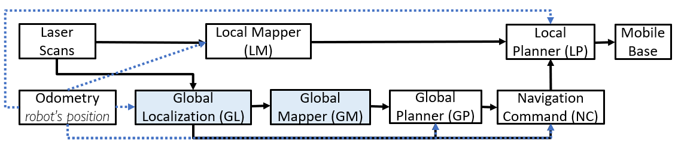
Robots run complex applications
Global Localization & Mapping
Local Mapping
Notes:
global localization & mapping – basically SLAM

Slide 6
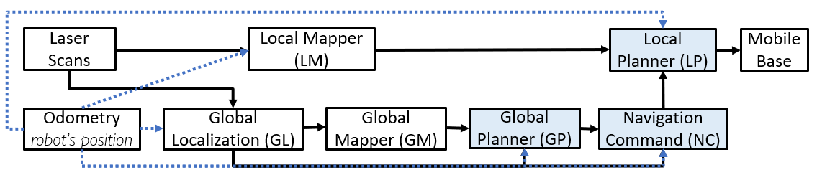
Robots run complex applications
Global Localization & Mapping
Local Mapping
Path planning
Notes:
and trajectory planning

Slide 7
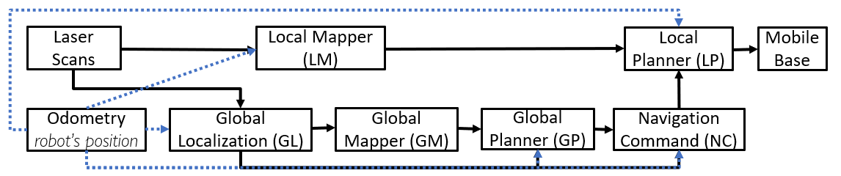
The need to manage CPU resources
Tasks (nodes) can be run at different rates
Ideally, run all tasks on separate cores at very high rate
But, not enough CPU resources
Notes:
Now, all these nodes/tasks can be configured to run at different rates. Ideally, we’d like to run all of them on different cores, at very high freq – so we have fresh maps, localization, and fresh trajectories. But, we can’t afford to do this because there’s only limited CPU available.

Slide 8
The need to manage CPU resources
Need to tradeoff CPU resources among nodes. But How?
Local Mapper at low rate => Collisions
Less CPU to Global Localization & Mapping => Unsafe trajectories
Less CPU to Planning => Slow exploration
Notes:
So, we’ll need to somehow tradeoff CPU resources among nodes – but, how? if we
a. run LM at low rate: wont be able to detect nearby obstacles and hence the robot might collide, b. give less resrc GL,GM: wont know the robot’s latest position,which might lead to unsafe or even infeasible trajectories, c. at the same time, if we give less CPU to planning: we would run stale trajectories which might slow down exploration.

Slide 9
Need to manage CPU resources based on application goals
Important to manage CPU resources so as to meet application goals:
Avoid collisions
Plan trajectories correctly
Complete exploration quickly
Notes:
Hence, it is important to manage CPU in a way so that we meet application goals/requirements.
For navigation, the 1st goal would be, to avoid collisions, second, to plan robot trajectory ‘correctly’ based on robot’s latest position. Third, that the robot should be able to explore and map the whole are as quickly as possible.

Slide 10

ROS Developers manually tune parameters today!
Increases development burden
Can be suboptimal: Manually tuned Nav2D configuration is not good at avoiding dynamic obstacles.
Notes:
Sadly, in current robotics development frameworks like ROS, this CPU scheduling is left upto the app developer, meaning that the developer has to manually tune the node exec rates as well as the cpu allocation for their application.
Not only does this increase the development burden, it can actually lead to suboptimal scheduling - as we will see in our results, a manually tuned config for Nav2d is actually unable to avoid collisions with dynamic obstacles.

Slide 11
Catan: Automating CPU Scheduling for Robotics
Reduces development burden
Requires only high-level inputs about application requirements
Automated CPU Scheduling to meet application goals
Achieves 8x better collision avoidance for Nav2D than manually-tuned config
Notes:
This is where our contribution comes in – our system Catan automates CPU scheduling for robotics applications so as to meet the application’s goals. With Catan, developers don’t have to worry about CPU mgmt. – we require only high-level inputs about appln requirements.
And, since our system takes into account appln goals for scheduling, we are able to get better schedules – as we’ll see in our results, we achieve 8x better collision avoidance than manually tuned config for Nav2d.

Slide 12
Why is CPU Scheduling hard?
3 main challenges
Notes:
Since this is an old problem, there has been a lot of work in automating CPU sched for robotics but it all falls short on 3 challenges that I will now discuss.

Slide 13
Challenge 1: Co-optimizing Scheduling Dimensions
Must automatically co-optimize all 3 dimensions based on app goals:
Spatial Core allocation: Divide cores across nodes
Temporal CPU Allocation: Split CPU time across nodes
Execution Rate: Frequency of each node
Prior works: Take execution rates or spatial allocation as input
Notes:
The first challenge is that we must automatically co-optimize all 3 dimensions simultaneously, based on appln goals. Specifically, we need to configure the spatial core allocation: meaning which nodes can run on which cores, we then we need to configure temporal cpu allocn: meaning how much CPU time does each node get, and last, we also need to simultaneously tune the execn rate or frequency at which each node should be run.
No prior work achieves this, they either take execution rates Or spatial allocation as input.

Slide 14
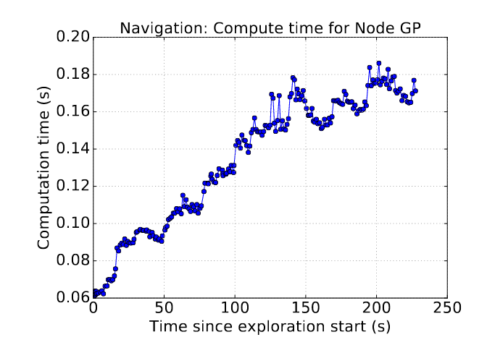
Challenge 2: Handling variability in compute usage
Prior works assume constant compute usage:
Provision for worst case => Under-utilized at start
Provision for best case => Overload near end
Notes:
The 2nd challenge is handling variability in compute usage. Here, we have plotted the compute usage of the Global planner node on y-axis, in seconds, and we observe that, as time goes by (x-axis), the robot explores a larger area, and the GP takes longer to run.
But, most prior works assume that the compute usage of each component is constant, this can be suboptimal, e.g. if we provision based on worst case exec time, we’ll run GP at low rate: meaning that we’ll have stale trajectories in the beginning & that the CPU would be under-utilized in 1st half, on the other hand, if we provision for the best case i.e. running at high rate: we’ll overload the CPU in the 2nd half. Hence, its important to model this variability while managing CPU.

Slide 15
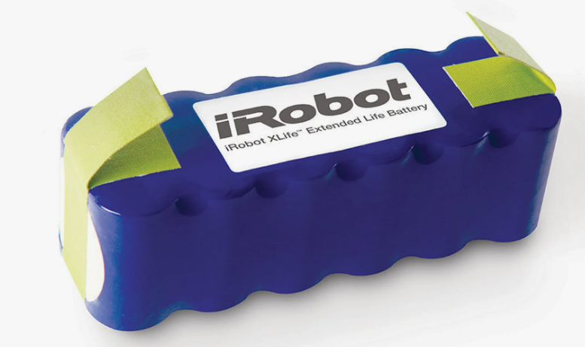
Challenge 3: Handling varying CPU availability
Common ways to save battery:
Turn off a core
Reduce the frequency of all cores
No prior work handles this
Notes:
The 3rd challenge is about handling varying CPU availability. It is quite common for robots to either turn off a core or to reduce the freq of all cpu cores to save battery. But, none of the prior works handle this.

Slide 16
Our contribution - Catan
Catan solves all 3 challenges simultaneously!
Notes:
Our system, Catan, is able to solve all these 3 challenges.

Slide 17
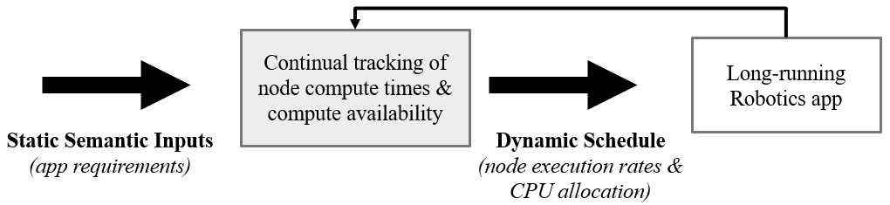
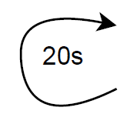
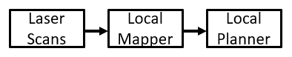
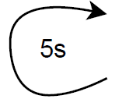
Catan Design
Collision Avoidance ≈
Low latency & throughput for chain
Constrained Optimization Problem:
Stage-I: Spatial Allocation
Stage-II: Temporal & Exec rates
Notes:
Lets see how - This diagram shows an overview of our system:
Catan Takes the Application performance goals as input – and these goals are represented in terms of low-level metrics, e.g. collision avoidance can be expressed as requiring low lat & tput for the chain s-LM-LP.
Catan then automatically computes the right CPU schedule, by formulating a 2-stage constrained optimization problem: S-I solves for spatial alloc and S-II solves for temporal alloc and node exec rates.
Its able to meet the dynamicity challenge by continuously tracking the compute usage of each node and the compute availability, and then dynamically re-solving the 2 optimization problems to update the CPU schedule.
More details of our design can be found in our paper.

Slide 18

Evaluation - Setup
Implemented Scheduler as a ROS node over Linux
Notes:
Starting with the setup for our evaluation – we implemented our scheduler as a node in ROS over linux.

Slide 19
Evaluation - Setup
Implemented Scheduler as a ROS node over Linux
Simulated P3AT robot running Nav2D in Stage
Notes:
Simulated P3at robot in Stage, which is a popular 2d simulator.

Slide 20
Evaluation - Baseline
Comparing Catan to default configuration
Execution Rates hand-tuned by developer
Temporal CPU Allocation: Linux CFS (Completely Fair)
Notes:
In terms of the baseline, we compare catan to the default or manually-tuned configuration of Nav2d, wherein the execn rates are set by the developer for all the nodes in the nav2d dag.
Temporal CPU allocn is left to linux, which uses its default policy of CFS – i.e. all nodes get an equal share of the CPU. We wont discuss spatial allocn results today.

Slide 21
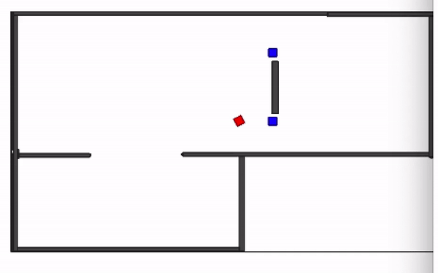
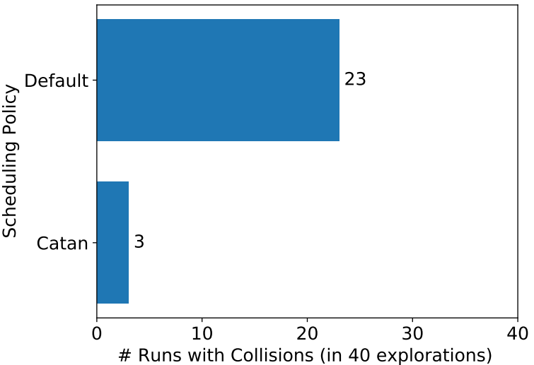
Goal 1: Better Collision Avoidance
Over 40 Runs of Nav2D robot on 1core: ~8x better!
Notes:
Lets start with the results: for evaluating collision avoidance, we simulated the robot on this map with 2 dynamic obstacles (blue squares), we run it 40 times.
What We see is that, when the default config is used, the robot ends up colliding with an obstacle in 23 runs out of 40,! Whereas, when Catan is used, the robot has a collision only 3 times out of 40 : giving an almost 8x improvement in collision avoidance.

Slide 22
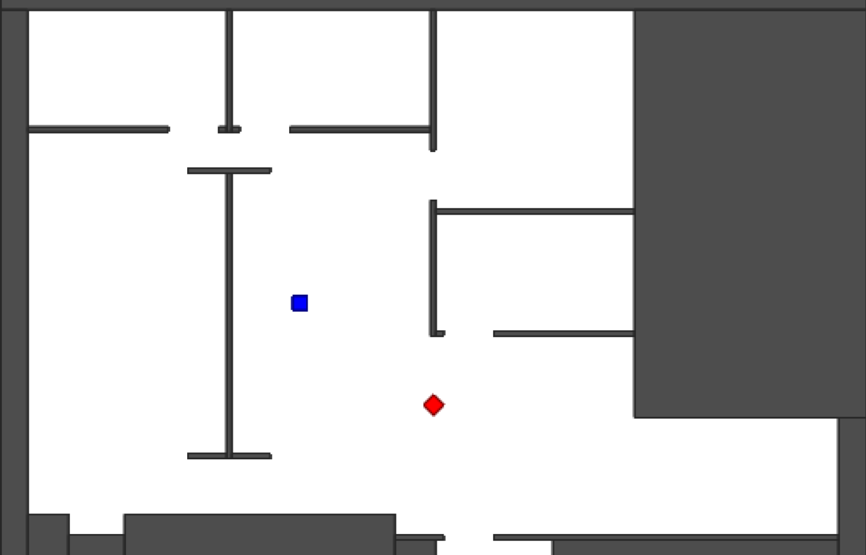
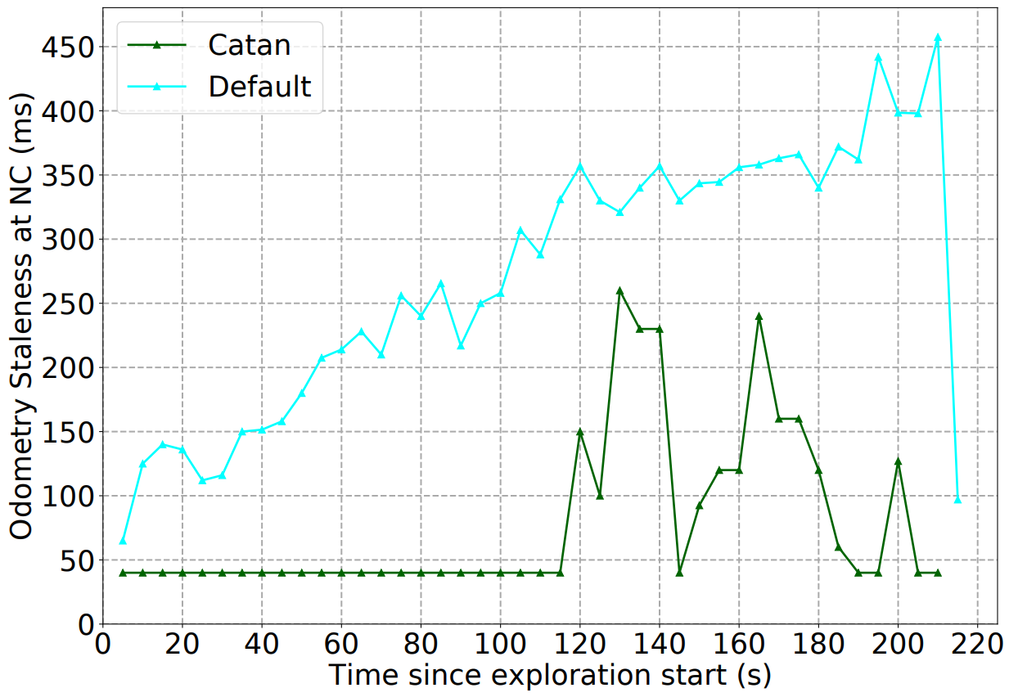
Goal 2: Better Odometry Staleness
Over 20 Runs of Nav2D robot on 1core: Upto 9x better!
Notes:
For evaluating trajectory planning,:, we simulate the robot on this map with no dynamic obstacles and a large area - we run it 20 times, and the metric we consider is odometry staleness at NC, which represents how stale is the robot position being used to generate the robot’s path.
We have the results On the right, with the time since robot’s exploration start on x-axis, and on y-axis, we have the median odometry staleness at NC across 20runs. We observe that Catan (green line) consistently achieves lower staleness as compared to the default – upto 9x at some points.

Slide 23
More Results
Catan Overheads (<5%)
Nav2D - Handling compute usage variability
Nav2D - Handling varying #cores
Face-tracking Robot application
VR Headset (ILLIXR System)
[Details in arXiv version]
Notes:
More results iin the paper – for Nav2d, we evaluate Catan’s overheads, we see how Catan handles compute usage variability, and varying #cores. In our arXiv paper, we have results for 2 more applications – a. face tracking robot and b. a VR headset (running on ILLIXR)

Slide 24
Conclusion
Managing CPU for robot applications is important
Discussed challenges in automating CPU scheduling
Built Catan that manages CPU given application requirements
Catan achieves ~8x lower collisions and upto 9x lower odometry staleness for Nav2d than the hand-tuned configuration

Slide 25
Thankyou! Questions?
IEEE/RSJ International Conference on Intelligent Robots and Systems

